Slide 1
Productivity: Personal and Social Software Processes
Slides adopted from Prof. Chris Parnin, some material based on Watts Humphrey’s notes

Slide 2
Activity
What makes you most unproductive?
Groups of 3-4: Discuss within group what makes you unproductive and how to improve.
Share: Some examples with class.

Slide 3
Productivity Drains in Workplace
Interruptions
Task Fragmentation
Task Fatigue; Motivation
Delayed Feedback

Slide 4
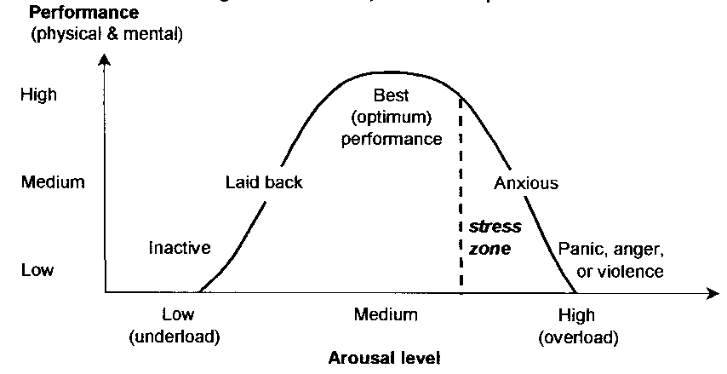
Typical productivity strategy
Parkinson's law is the adage that "work expands so as to fill the time available for its completion"
+
Procrastination
+
Murphy's Law ("If anything can go wrong, it will")
Yerkes–Dodson law

Slide 5
Productivity Strategies
Pomodoro; Timeboxing
Headphones
Task Paths; Location-boxing
Stress
Self-sourcing
Personal trackers, metrics
… anything on lifehacker…

Slide 6
Research on productivity

Slide 7
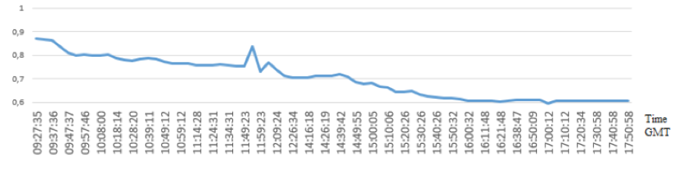
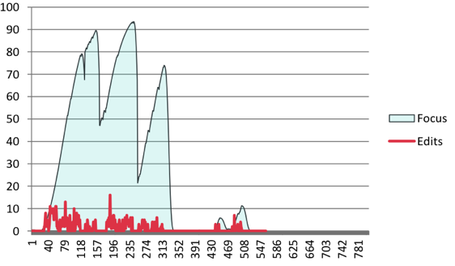
Why is productivity important for programming?
A programmer takes between 10-15 minutes to resume work.
Only 10% of times did a programmer resume work in less than a minute.
A programmer is likely to get just one uninterrupted 2-hour session in a day

Slide 8
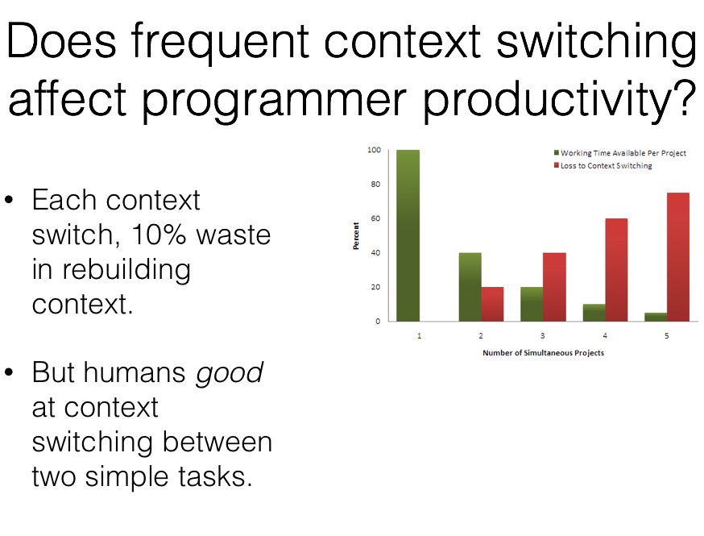
http://bvasiles.github.io/slides/icse16talk.pdf

Slide 9
Personal productivity
Caveat: Like diets, everything in moderation, individual variance exists.

Slide 10


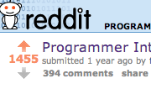

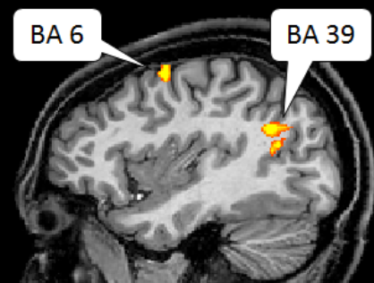
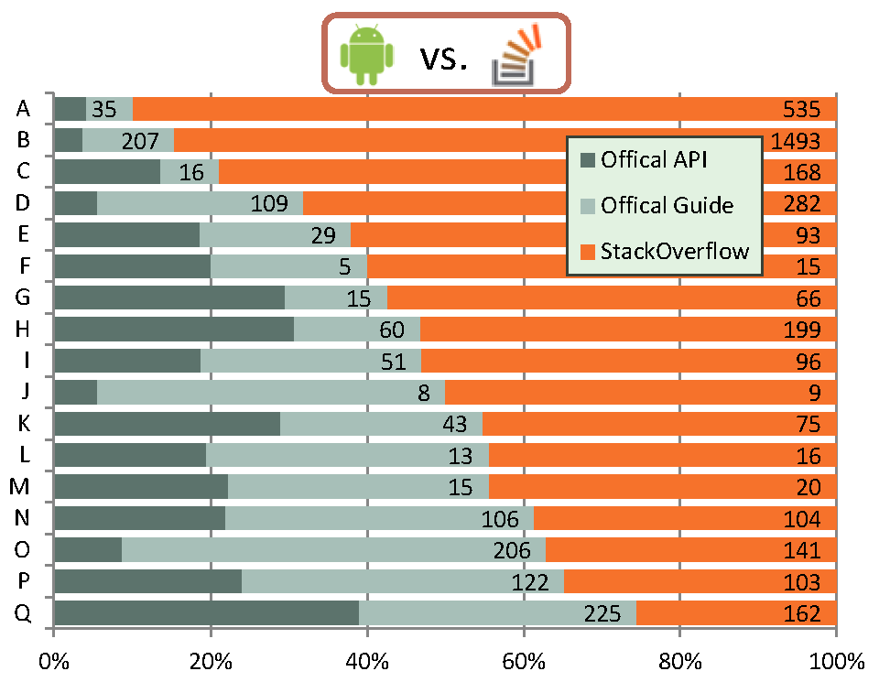
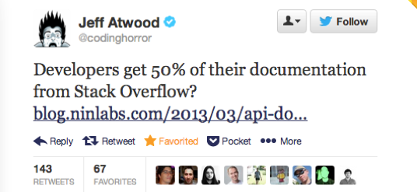
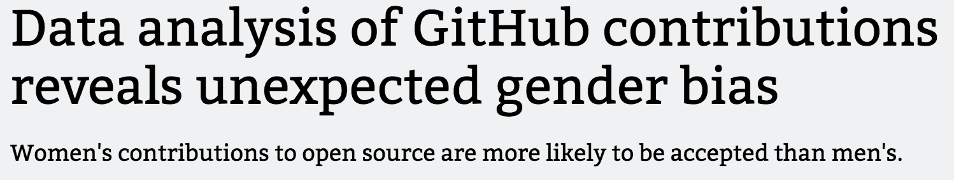
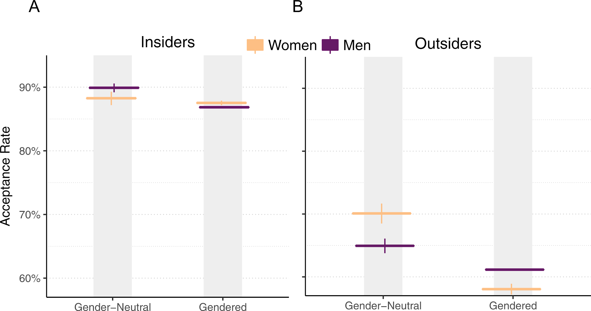
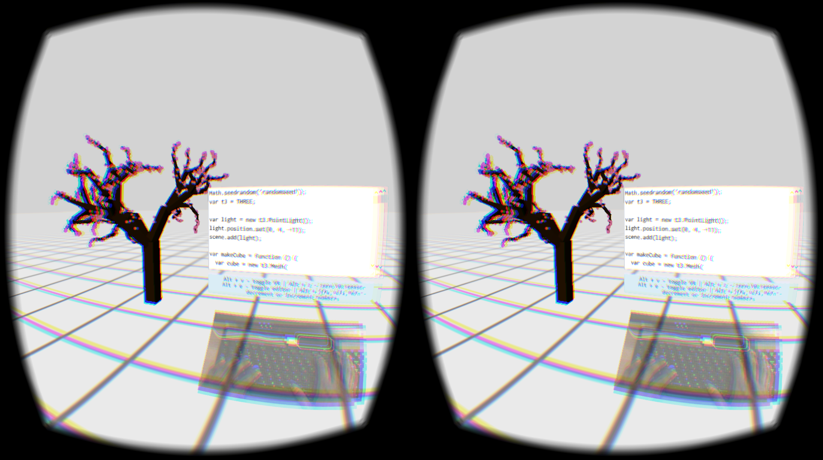
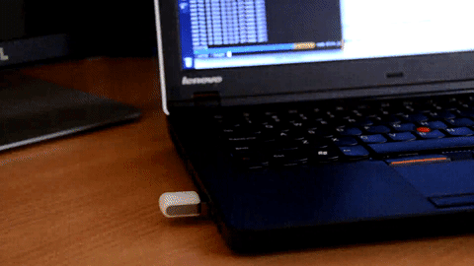


Data-Driven Productivty Studies

Slide 11

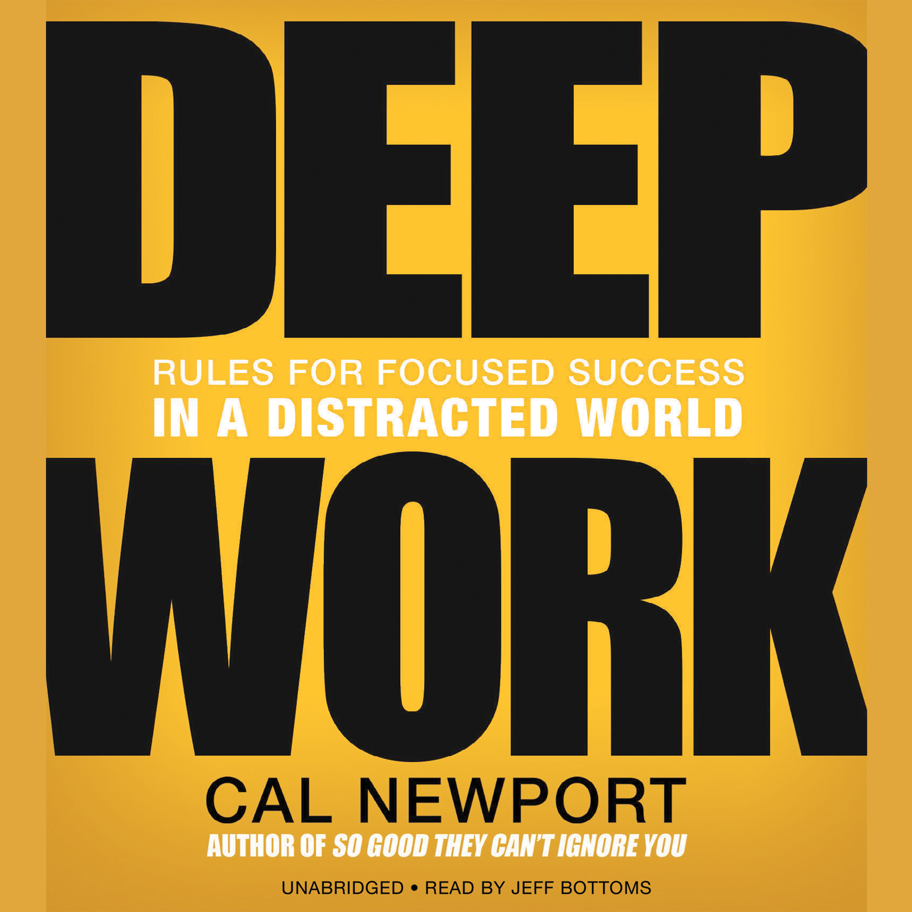
Two Modes of Work
TODO
DO

Slide 12
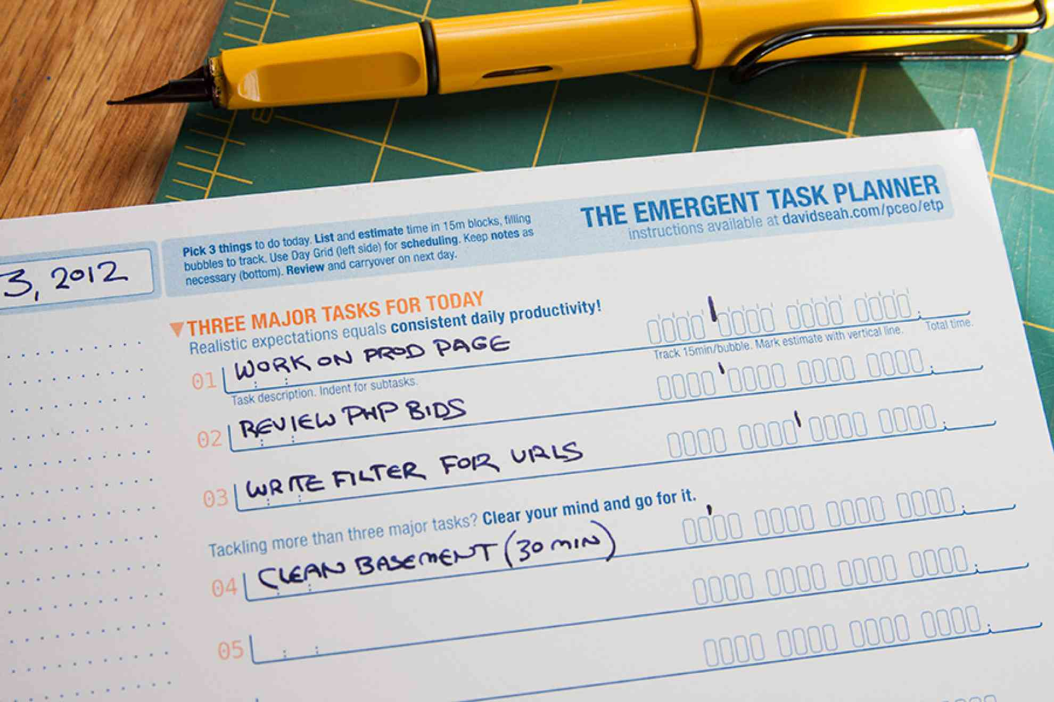
TODO
Useful paper tool for tracking items for the day.
https://davidseah.com/node/the-emergent-task-planner

Slide 13
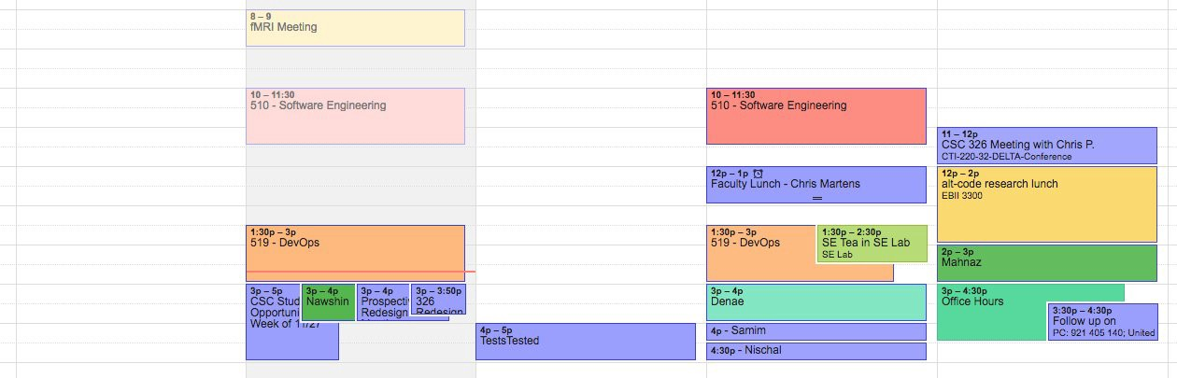
Deliberate Work
Work frequently and deliberately on goals that matter.

Slide 14
On a Deliberate Work Day
Before working:
No checking email when you first wake up.
Have a clear goal for the day: Working on introduction for ICSE paper.
No urgent tasks for the day. Too much stress kills deep focus.
Clearing space: No meetings in middle of day.

Slide 15
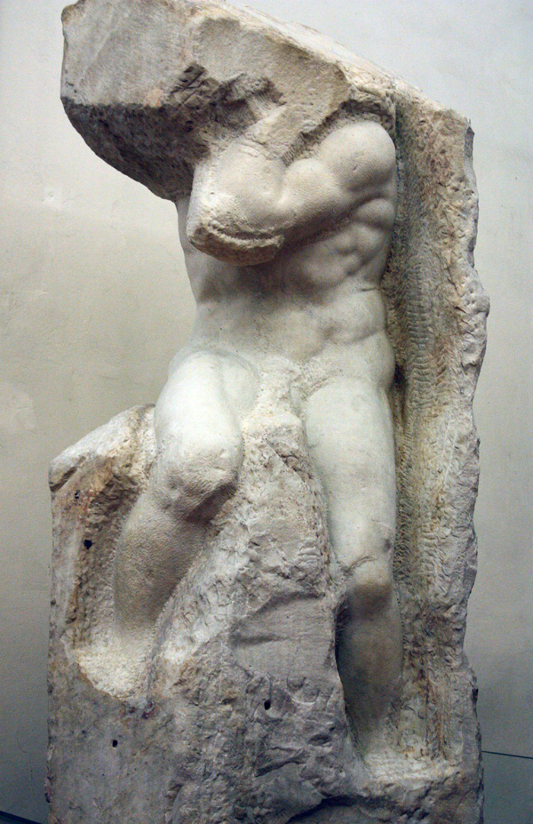

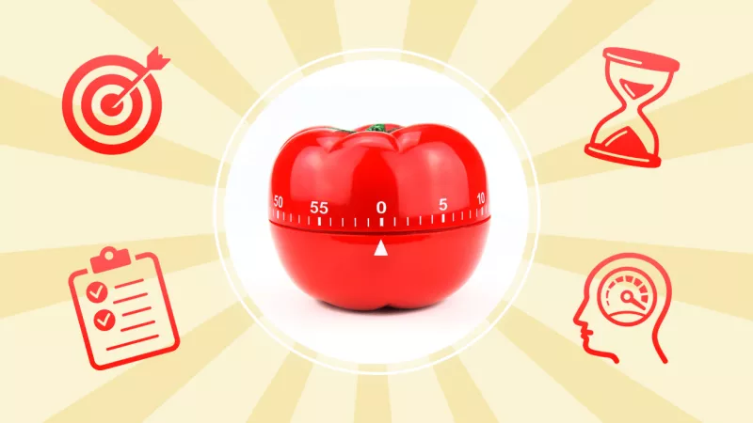
On a Deliberate Work Day
Getting into Focus:
Your primary challenge is getting motivation to work on something hard and uncertain. Your brain requires about 15 minutes to switch attention to a task.
Start with the simplest task possible: Do basic environment preparation (open up word document, Eclipse, find instructions in Browser).
Wait 15 minutes before working.
Do a very simple task related to your main goal.
Task Light
Pomodoro

Slide 16
On a Deliberate Work Day
Working
Work 2-4 hours on your goal. Brain can only focus on intense task work for about 4 hours. Will take several weeks before you can reach this level of work.
Ignore external sources. Pause Inbox on email/snooze notifications.
Put phone physically away (in bag). [improves focus]
Do a very simple task related to your main goal.
https://news.utexas.edu/2017/06/26/the-mere-presence-of-your-smartphone-reduces-brain-power/

Slide 17
On a Deliberate Work Day
Advanced Strategy:
Location-boxing
Learn to associate certain types of places for types of work (Library => writing, Cup of Joe: Coffee Shop => coding, etc.)
Switch locations when you switch tasks. This will give you a bonus in motivation, plus chance to reflect on progress.

Slide 18
On a Deliberate Work Day
Stopping:
Learn to when your energy levels has depleted.

Slide 19
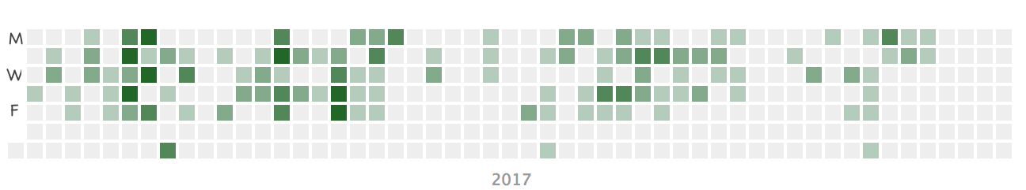
Deliberate Work sessions

Slide 20
Principles and constraints
No working at (late) night: Only able to work from 9:30am–5pm during the week
Have to time commute via walking/biking into work(space)
Being able to limit schedule and communication.

Slide 21
Other days
Helping others be productive.
TODO mode ON.

Slide 22
Implications and Issues
Expensive to be working in coffee shop + weight gain.
Need to balance personal productivity goals with other external needs.
Less time in office/interaction with others.

Slide 23
Summary
Make sure to allocate time every week to work deliberately on an important goal.
Find strategies to keep you focused and motivated.
Stop early, work-stress free.
Beware of the costs to yourself and others with deep focus.
READ MORE:
http://bit.ly/deliberate-work
http://calnewport.com/books/deep-work/
Task planner: https://davidseah.com/node/the-emergent-task-planner

Slide 24
Activity
Groups of 3-4: Discuss some strategies you might find useful for completing your work.
Share: some with the class.

Slide 25
Software engineering methods

Slide 26
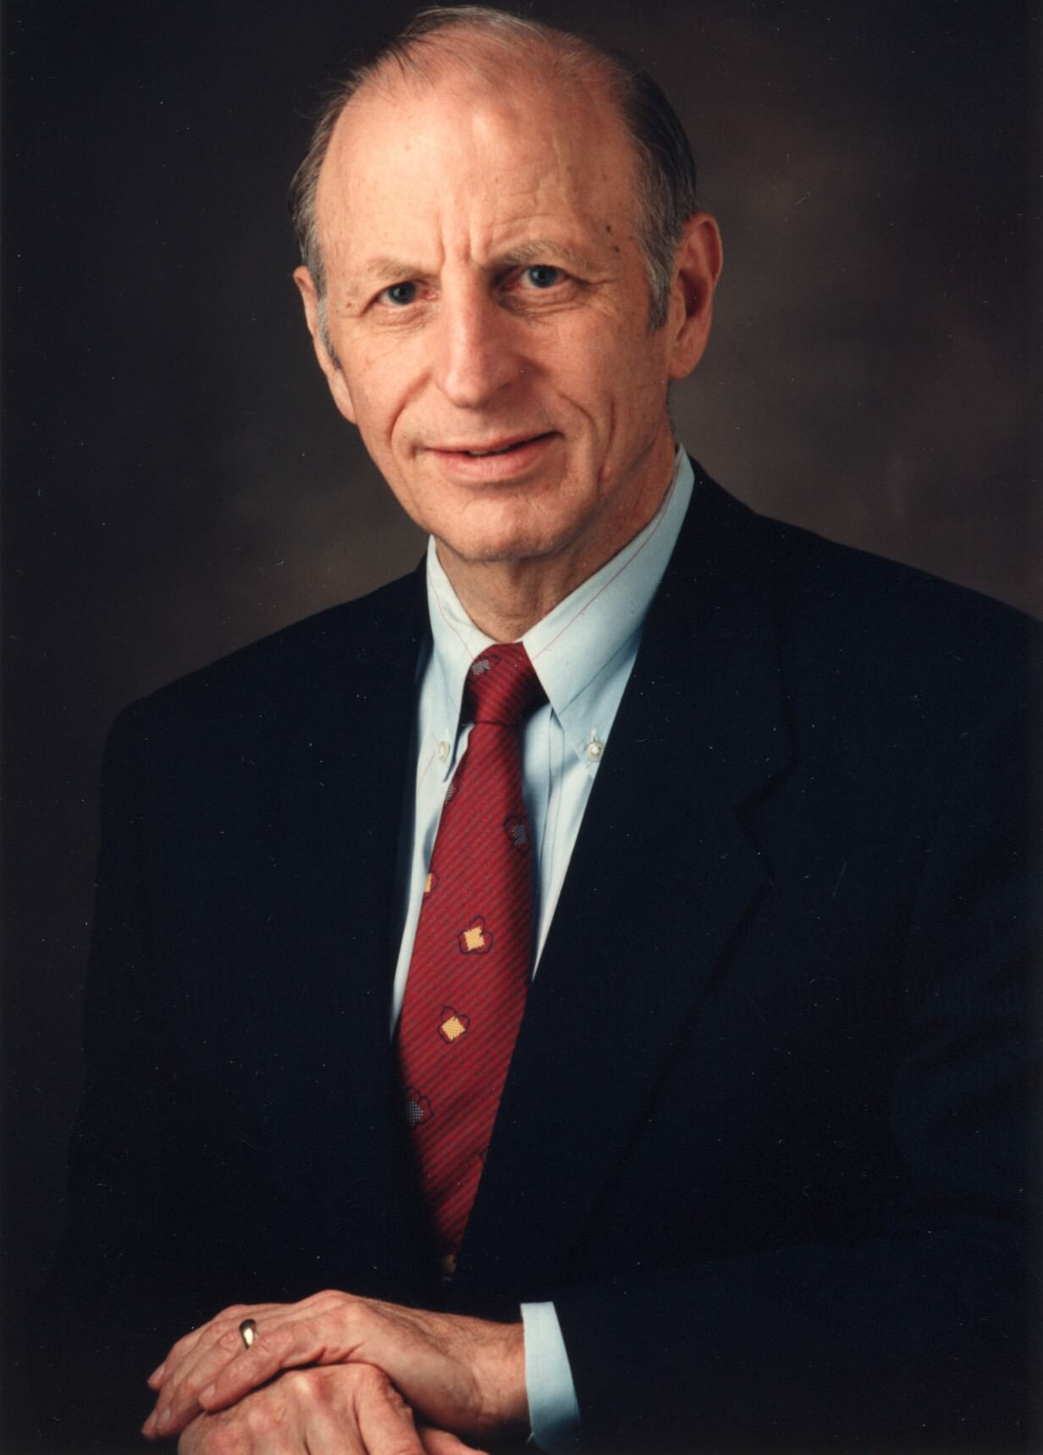
Personal Software Process (PSP)
Watts Humphrey
Plan, measure, track program quality throughout the lifecycle of a project.
Analyze metrics and use the results to improve process.

Slide 27
PSP SEI Training Course
Engineers write 10 programs.
They start with current skills.
They gather data on every program.
They use PSP to reflect on previous program.
After course, they understand how reflection => better work.

Slide 28
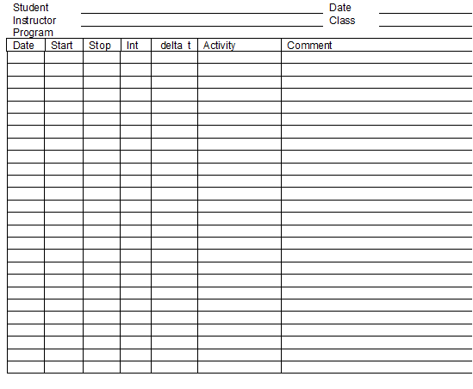
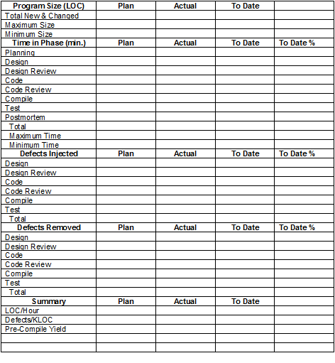
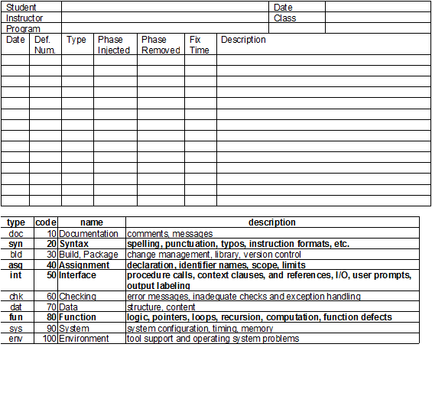
Metric Forms
Time Tracking
Plans
BUGS

Slide 29
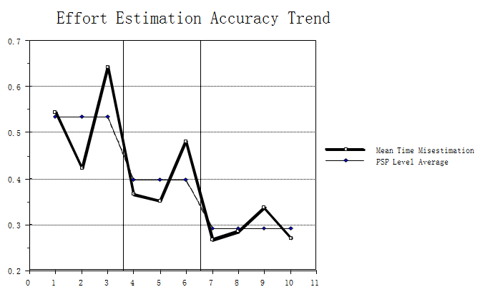
Accuracy of Estimation (minutes)

Slide 30
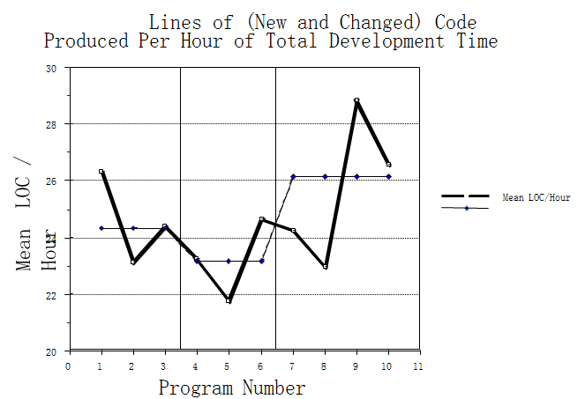
Productivity (LOC)

Slide 31
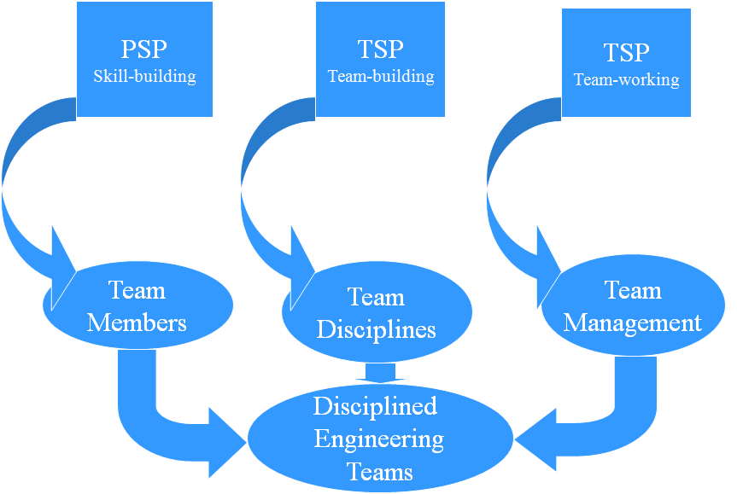
PSP + Team Software Process (TSP)
Personal measures
Process discipline
Estimating & planning
Quality management
Project goals
Team roles
Team process
Project plan
Balanced plan
Risk analysis
Team communication
Team coordination
Status tracking
Project reporting

Slide 32
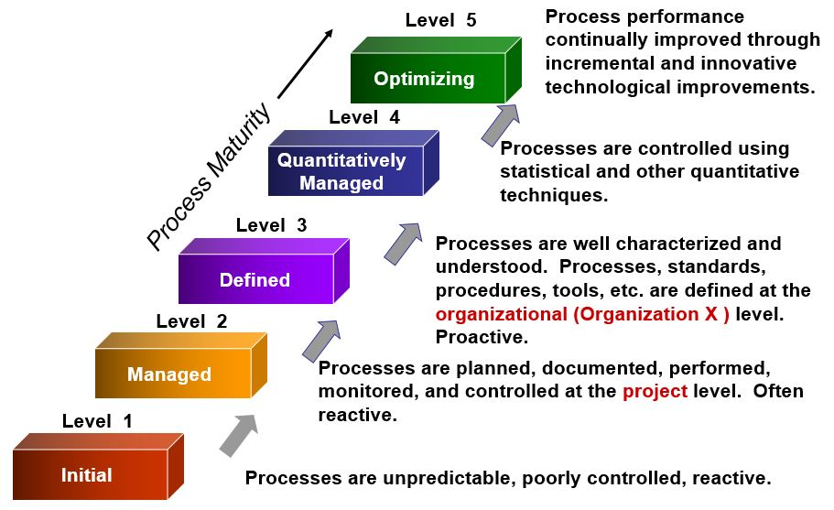
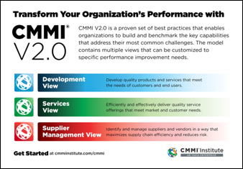
Capability Maturity Model Integrated (CMMI)

Slide 33
Modern Versions
Automatic Metric collection

Slide 34
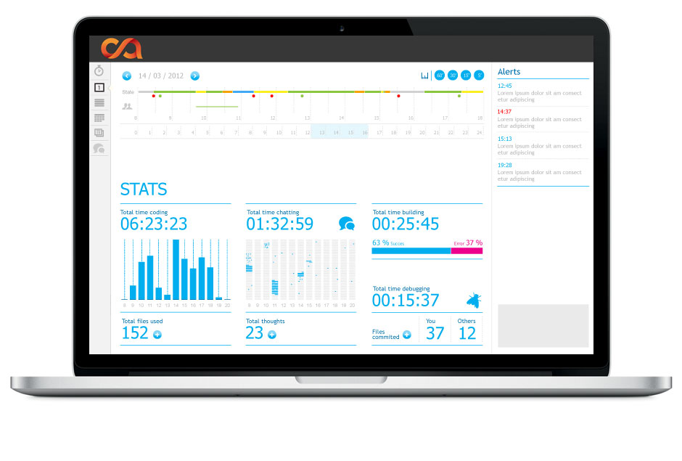
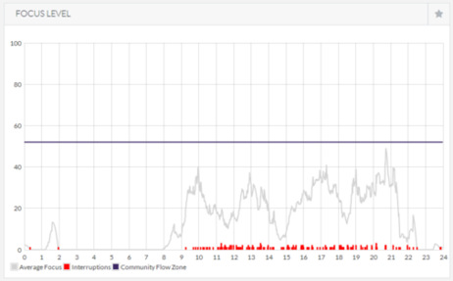
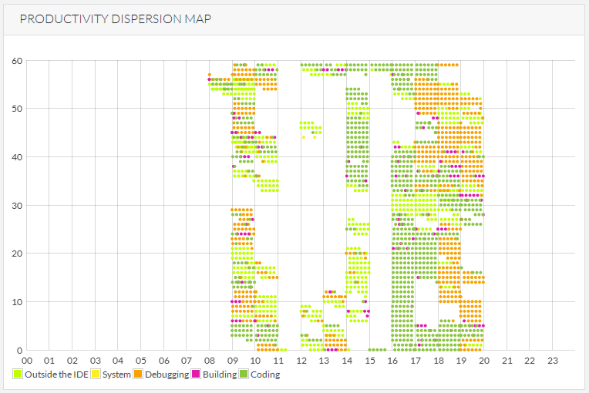
Codealike

Slide 35
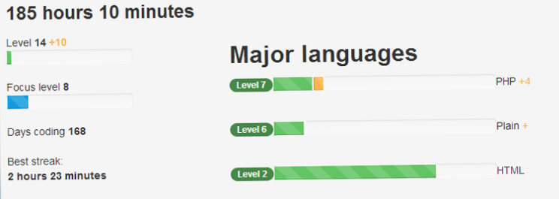
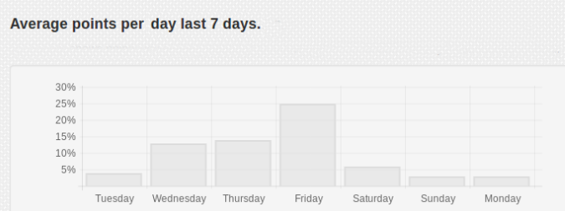
Codeivate (for Sublime Text 2+3)
http://www.codeivate.com/
See also: https://wakatime.com/

Slide 36
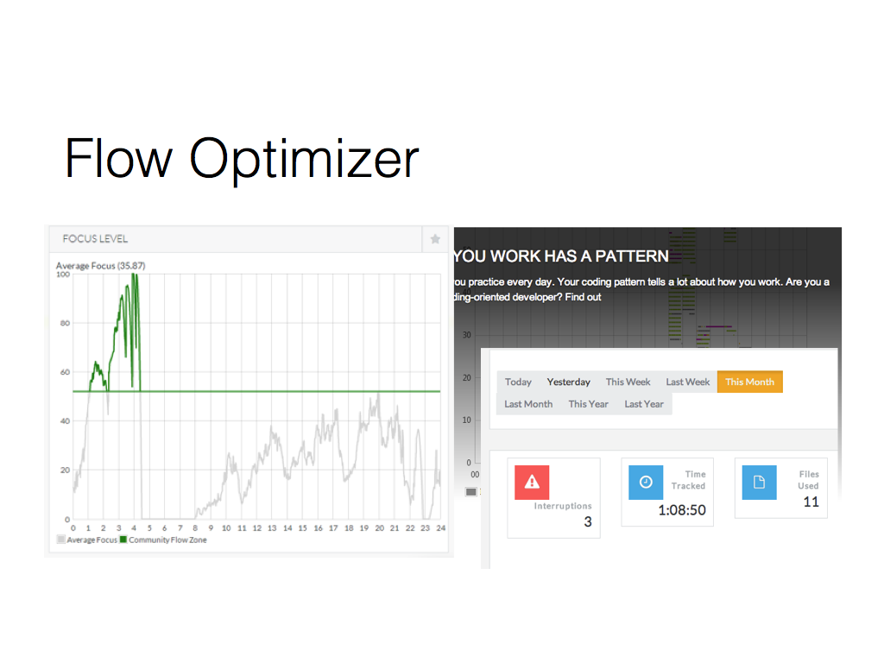

Slide 37
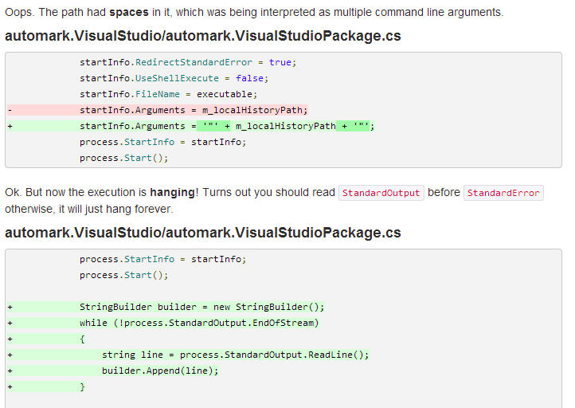
autogit + automark
Bugs, churn, etc.

Slide 38
Activity
Groups of 3-4: What might be some good things related to tracking progress.
What issues might you have with using PSP in your own work?
Share: some with the class.

Slide 39
Social Software Processes
Publicly sharing metrics.
Earning reputation points and badges for activity.
Signaling theory: Possessing hard-to-earn symbols or “signals” to project status or value.

Slide 40
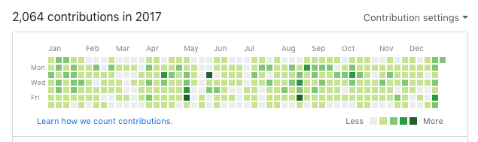
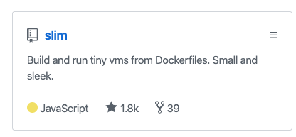
Github

Slide 41
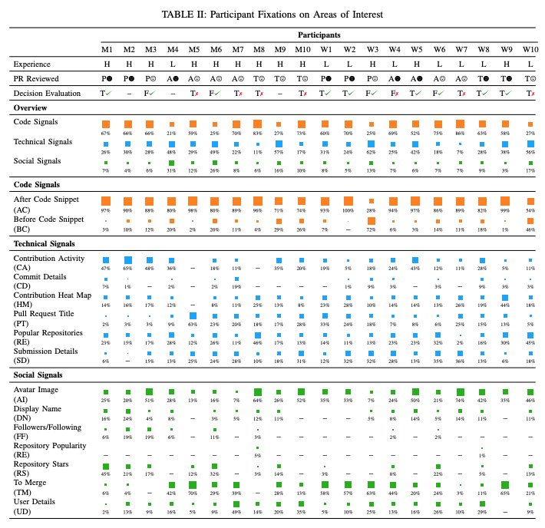
People will consider social signals in addition to technical signals.

Slide 42
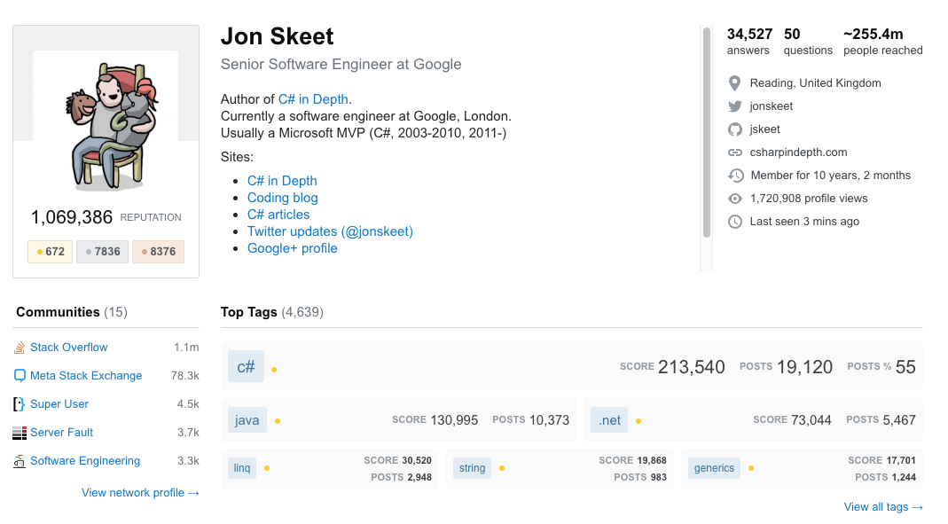
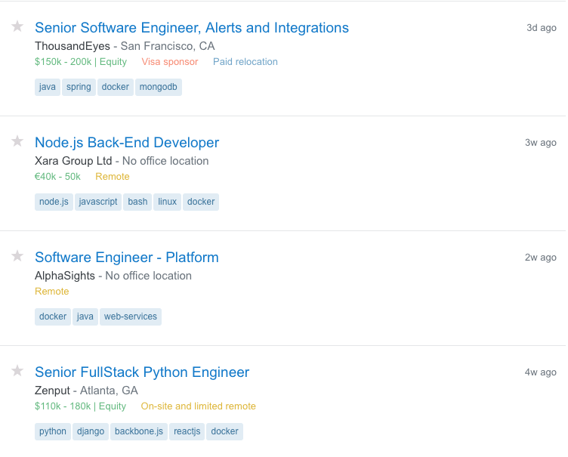
Stack Overflow

Slide 43
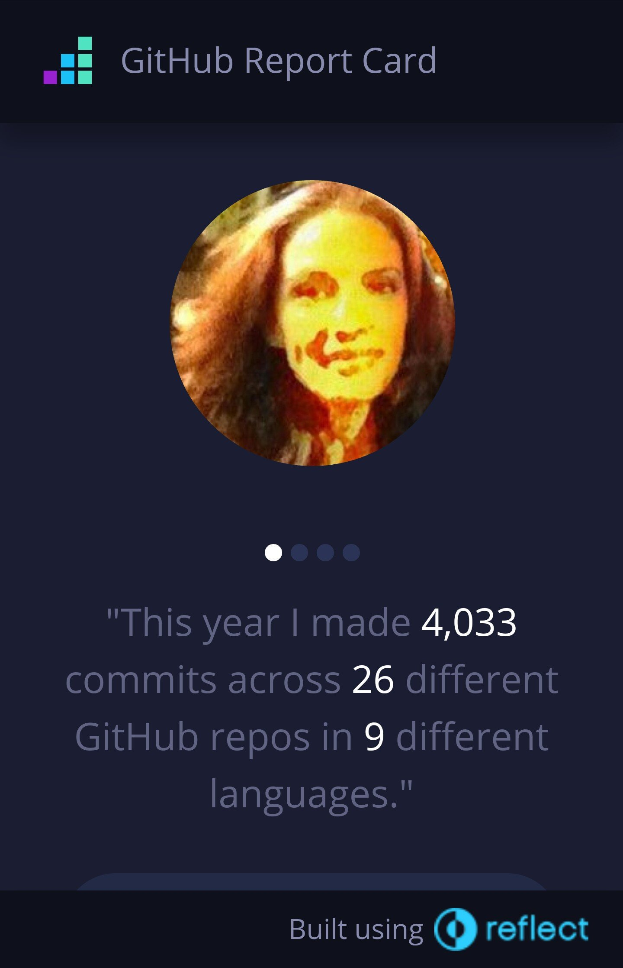
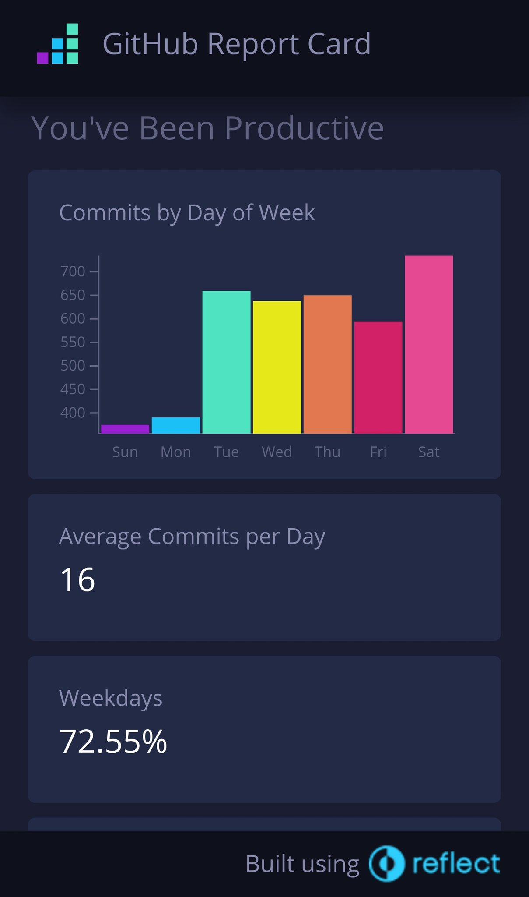
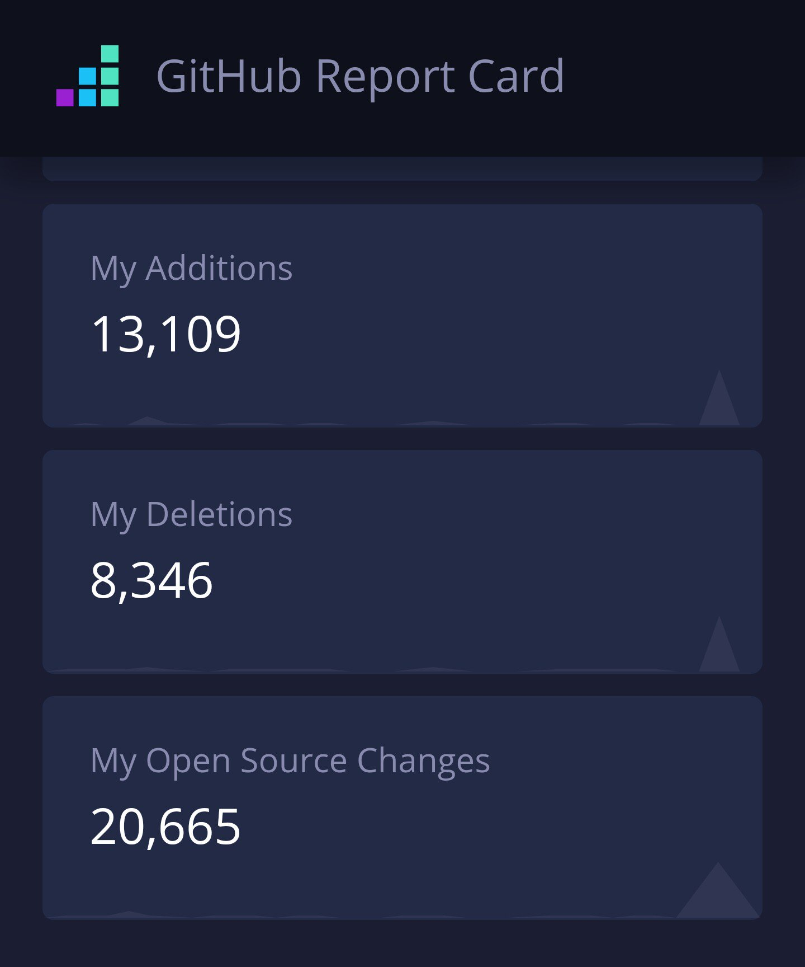
Github Report Card

Slide 44
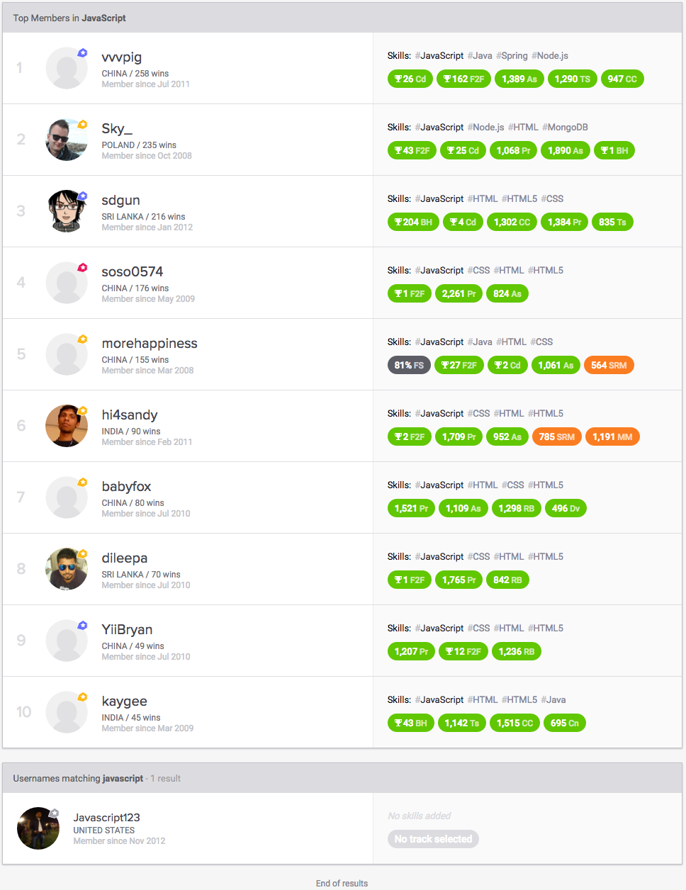
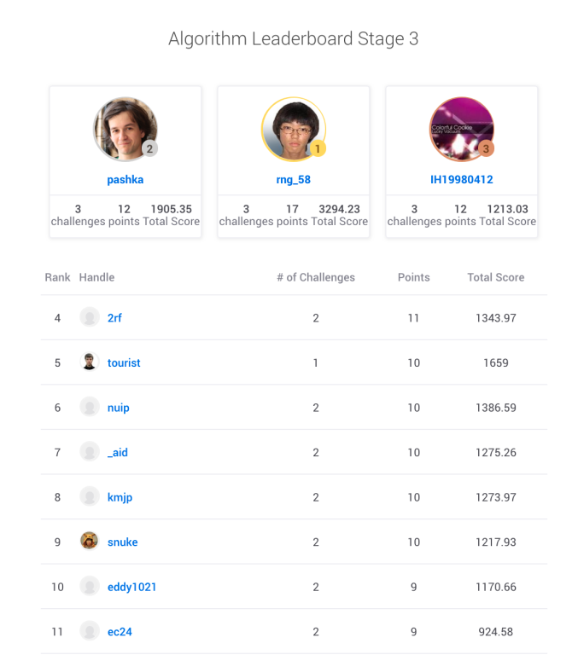
TopCoder Leader Board

Slide 45
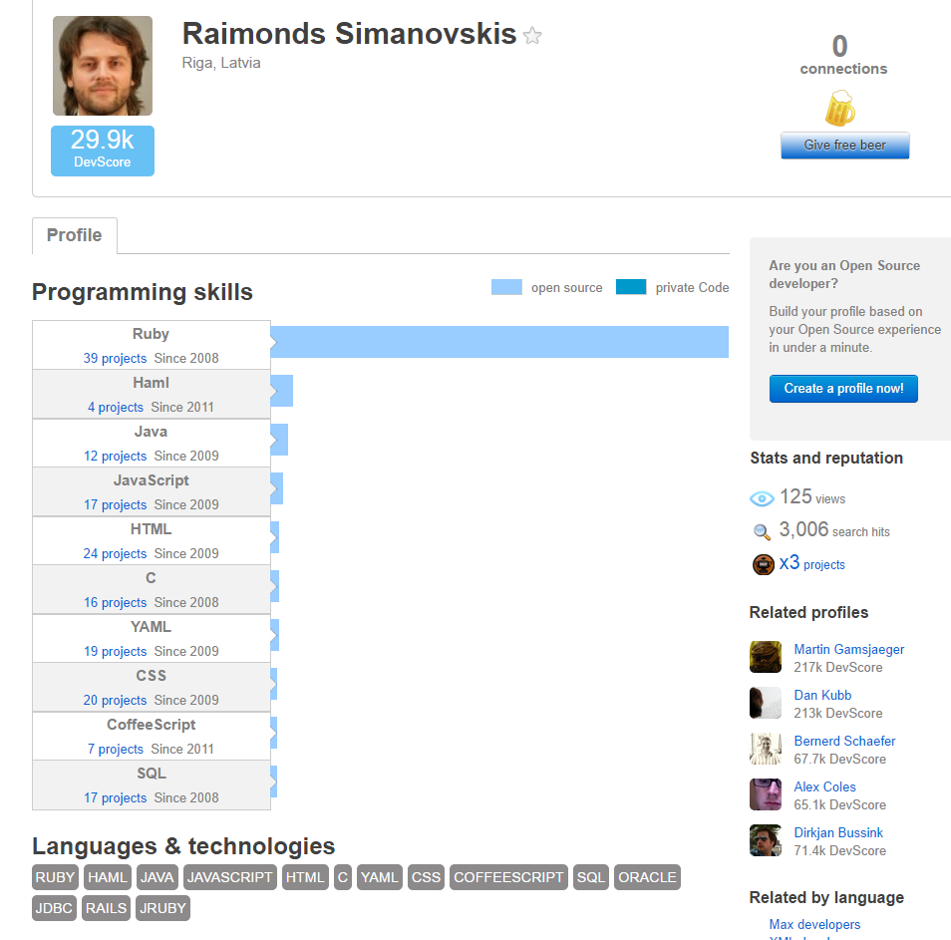
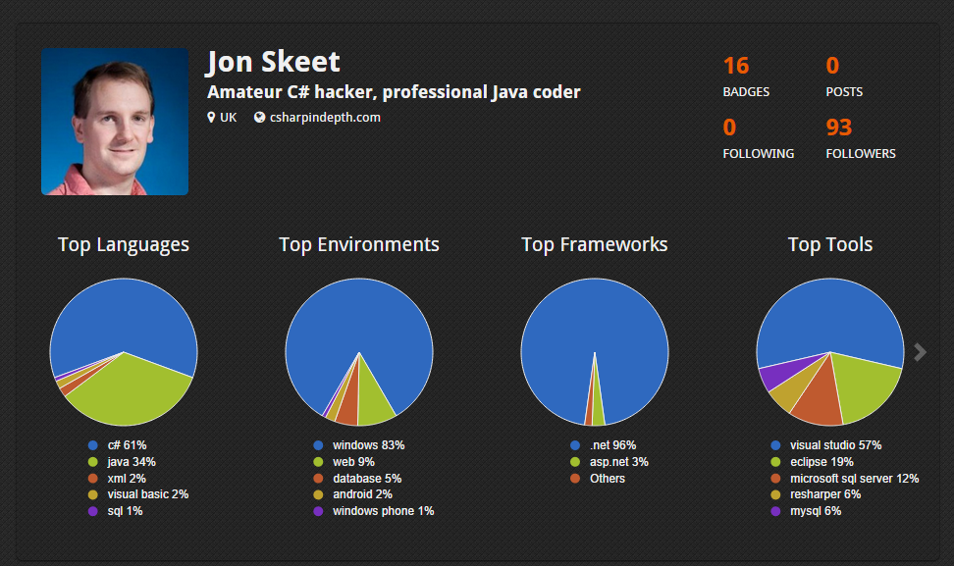
Masterbranch Coderbits
Notes:
Coderbits is a site that builds intelligent portfolios for software developers and designers.

Slide 46
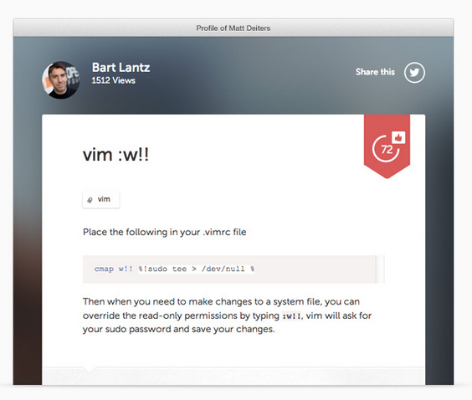
Coderwall
Notes:
The latest development and design tips, tools, and projects from our developer community

Slide 47
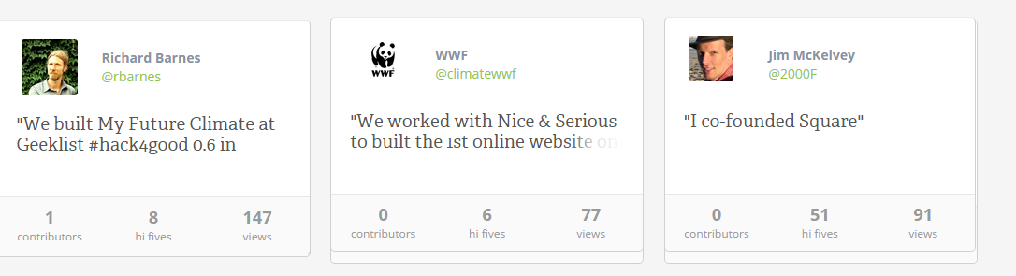
Geekli.st
Notes:
Geeklist is a social network for developers.

Slide 48
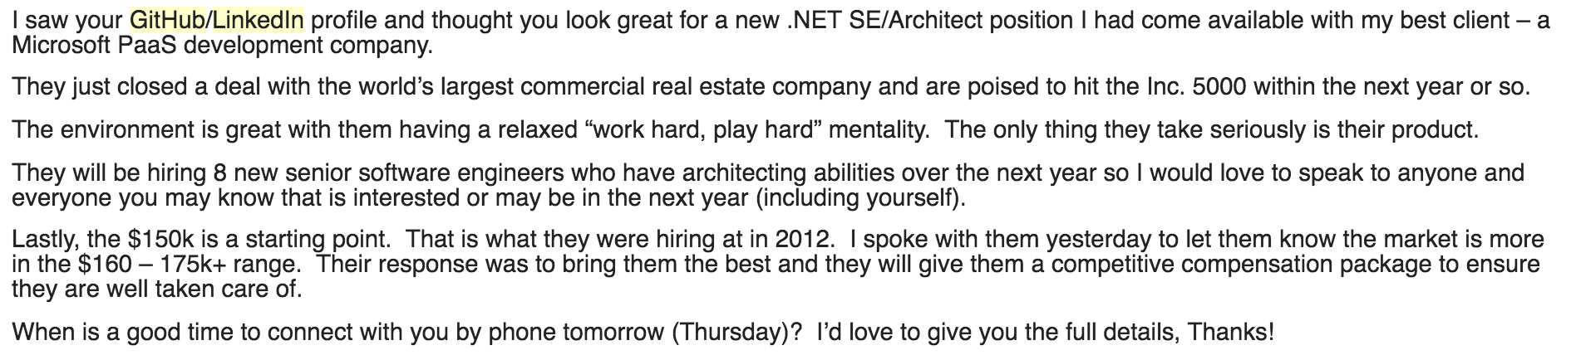
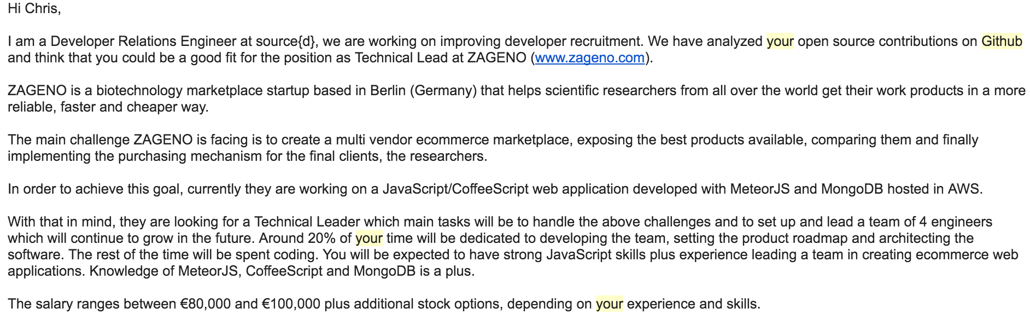
Resume?
https://www.benfrederickson.com/github-wont-help-with-hiring/
https://www.benfrederickson.com/github-wont-help-with-hiring/

Slide 49
Activity
Groups of 3-4: What are some neat things about social software processes?
What issues may arise?
Share: some with the class.

Slide 50
Data Science for Software Engineering

Slide 51

Data Science for Software Engineering

Slide 52

iRec: In-Process Worker Recommendation
“Non-Yielding Windows (NYW)”
NYWs distribution across testing cycles
https://conf.researchr.org/details/icse-2020/icse-2020-papers/16/Context-aware-In-process-Crowdworker-Recommendation

Slide 53

Next Course
SSW533 – Software Measurement and Estimation
What to measure?
How to estimate?
How to evaluate?
Lots of models

